Slide 1
SOCIAL ENGINEERING

Slide 2
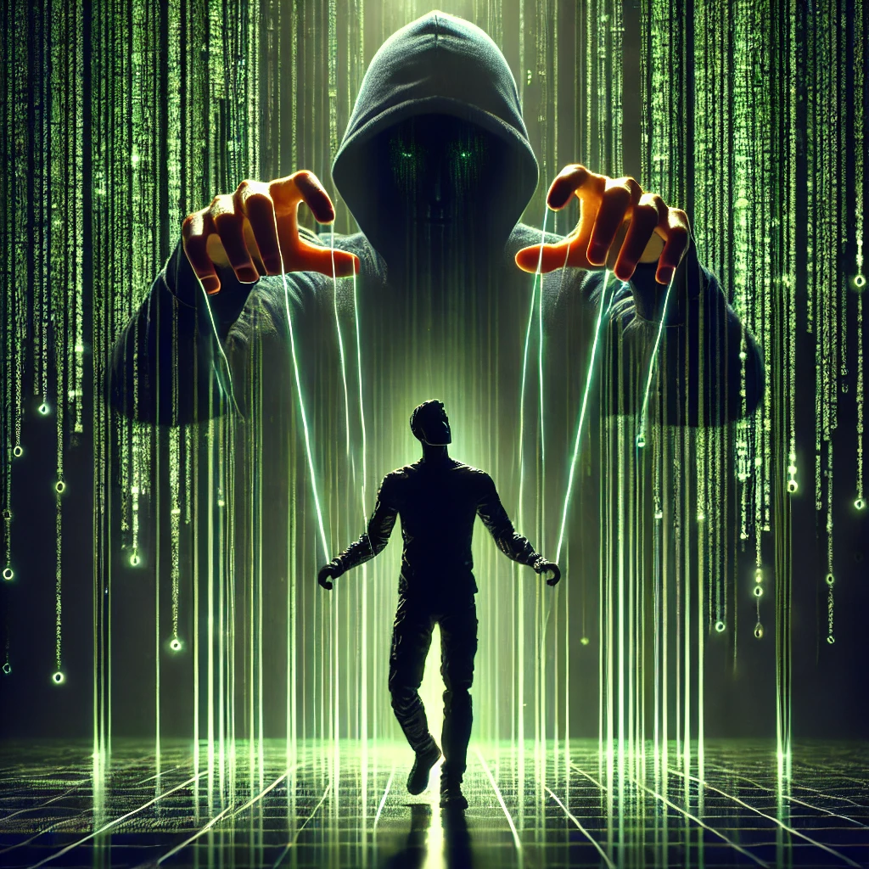
SOCIAL ENGINEERING
:-The Human Element of Cybercrime
SOCIAL ENGINEERING

Slide 3
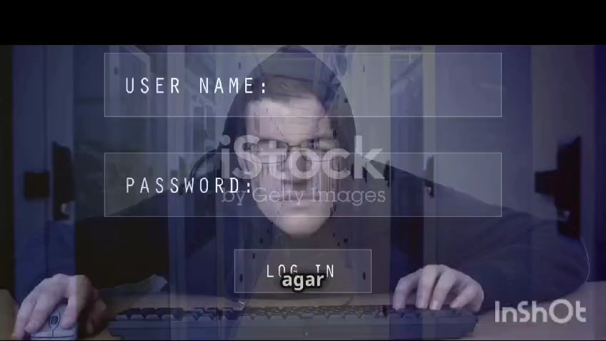
Social Engineering:
Social engineering is the manipulation of people into revealing confidential information or performing actions that compromise security, often through tactics like deception, impersonation, or emotional manipulation rather than technical hacking.

Slide 4
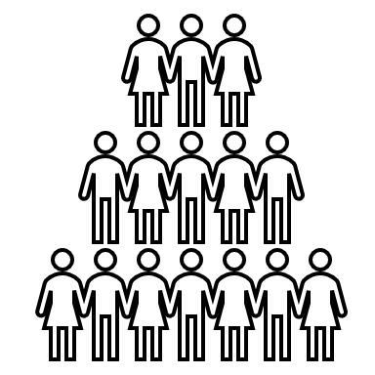



-:-WHY SOCIAL ENGINEERING IS SO DANGEROUS?
02
01
ITS GROWING RAPIDLY
Easier than hacking-people manipulation
Phishing, Malware,
Ransomwares
EVERYONE IS THE TARGET
No system is Immune
Both Technical and Non-technical people.
4 REASONS
03
04
EXPLOITS
Human emotion and trusts
IMPACT IS MASSIVE
Financial loss
Reputation Damage
Data breaches

Slide 5




PSYCHOLOGY TECHNIQUES
2
1
Authority
Posing as an authoritative figure (e.g., a boss or government official) makes it more likely the victim will comply with their demands.
Urgency
Attackers often create a sense of urgency (e.g., “Your account will be deactivated unless you act now!”) to force people to act without thinking.
Trust
Fear
Social engineers often impersonate trusted sources (friends, family, or known institutions) to lower a victim’s guard
Messages designed to scare you (e.g., “Your bank account has been hacked!”) are commonly used to manipulate people into quick, careless actions
3
2

Slide 6
-:-WHY RAISING AWARENESS ABOUT SOCIAL ENGINEERING IMPORTANT?
Humans are the weakest link in security: While most companies invest heavily in securing their networks and infrastructure, attackers know that a single employee or individual making a mistake can lead to a full-blown breach.
Prevention requires education: By understanding the techniques attackers use, individuals are more likely to recognize and avoid them. If both technical and non-technical audiences are trained to spot social engineering attempts, the chances of falling victim to them are greatly reduced.
Cost-effective defense: Educating employees and individuals about social engineering is one of the most cost-effective defenses for organizations and individuals. It prevents the need for costly recovery from breaches.
Reduces the Risk of Insider Threats: Educating employees and individuals about social engineering helps mitigate insider threats, whether intentional or accidental. Even well-meaning employees can be tricked into handing over sensitive information, but awareness training can help prevent these costly mistakes.

Slide 7
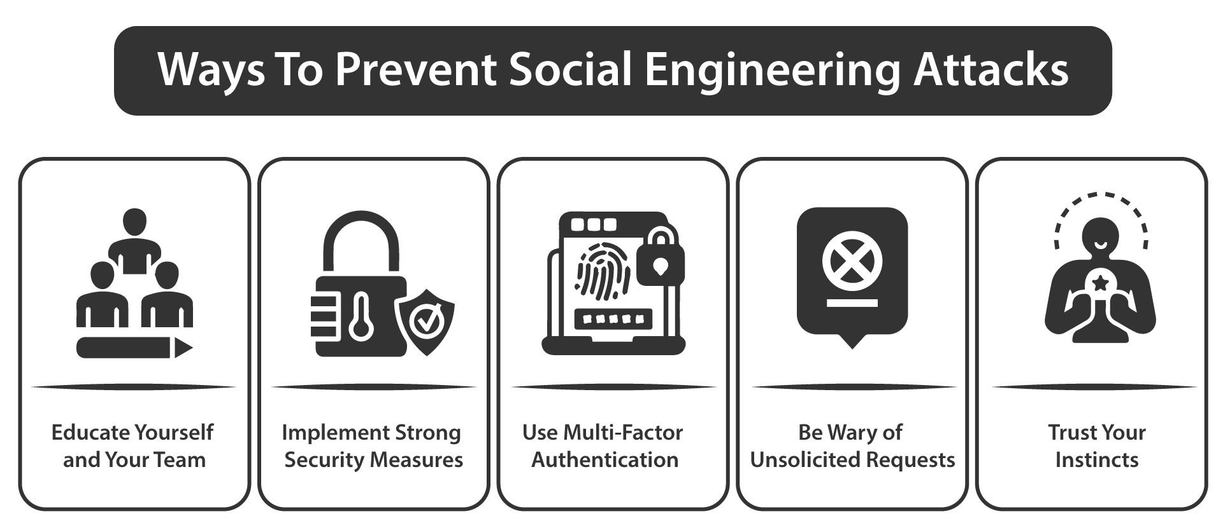
-:-HOW TO PROTECT YOURSELF?
Verify Suspicious Requests:
Enable Multi-Factor Authentication (MFA):
Limit Information Sharing: Be Skeptical of Urgency:
BE SKEPTICAL OF URGENCY
Regular Training and Awareness

Slide 8
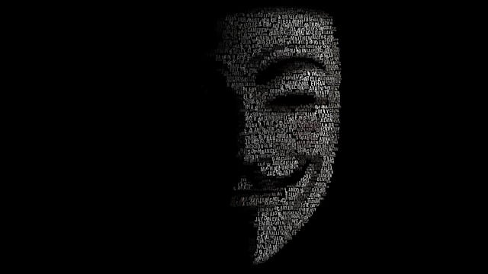
CASE STUDIES

Slide 9
1
2
3
4
5
6
7
8
9
0
1
2
3
4
5
6
7
8
9
0
1
2
3
4
5
6
7
8
9
0
1
2
3
4
5
6
7
8
9
0
Sewage Control System Attack
In 2000,a disgruntled employee attacked a sewage control system in Queensland,Australia,causing flooding within a million liters of sewage

Slide 10
1
2
3
4
5
6
7
8
9
0
1
2
3
4
5
6
7
8
9
0
1
2
3
4
5
6
7
8
9
0
Google & Facebook Fraud
1
2
3
4
5
6
7
8
9
0
A social engineer tricked these companies into sending $100 million through phishing emails.

Slide 11
1
2
3
4
5
6
7
8
9
0
1
2
3
4
5
6
7
8
9
0
1
2
3
4
5
6
7
8
9
0
1
2
3
4
5
6
7
8
9
0
The Twitter Hack
In July 2020, several high-profile Twitter accounts, including those of Barack Obama, Elon Musk, and Apple, were compromised through a social engineering attack

Slide 12

Thank You !
Secure Today ,Protect Tomorrow

Slide 13
Thank You !
Secure Today ,Protect Tomorrow

